Slide 1


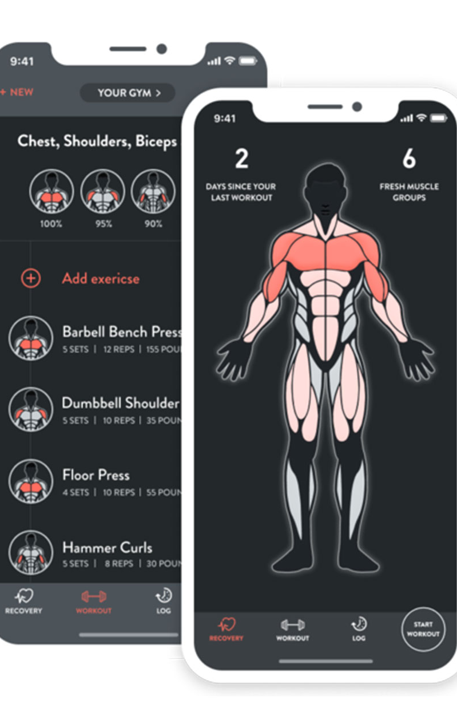

Workout Generator
Zion McGee
Generates a general and easily modifiable workout plan
https://github.com/ksu-is/fitness_planner

